Slide 1
Welcome!
The program will begin soon.
You will not hear audio until we begin.

Slide 2
Promoting a Culture of Belonging
JoAnn Meyer
Matthew Brierley
Lauren Aguilar
July 18, 2022

Slide 3

SPE Webinars are Sponsored by:

Slide 4


Lauren Aguilar, PhD
Founder + CEO | illuceo
lauren@illuceoinc.com
@drlaurenaguilar
Thank you!
Let’s connect.
DRIVEN BY DATA GROUNDED IN SCIENCE
DELIVERED WITH HEART

Slide 5
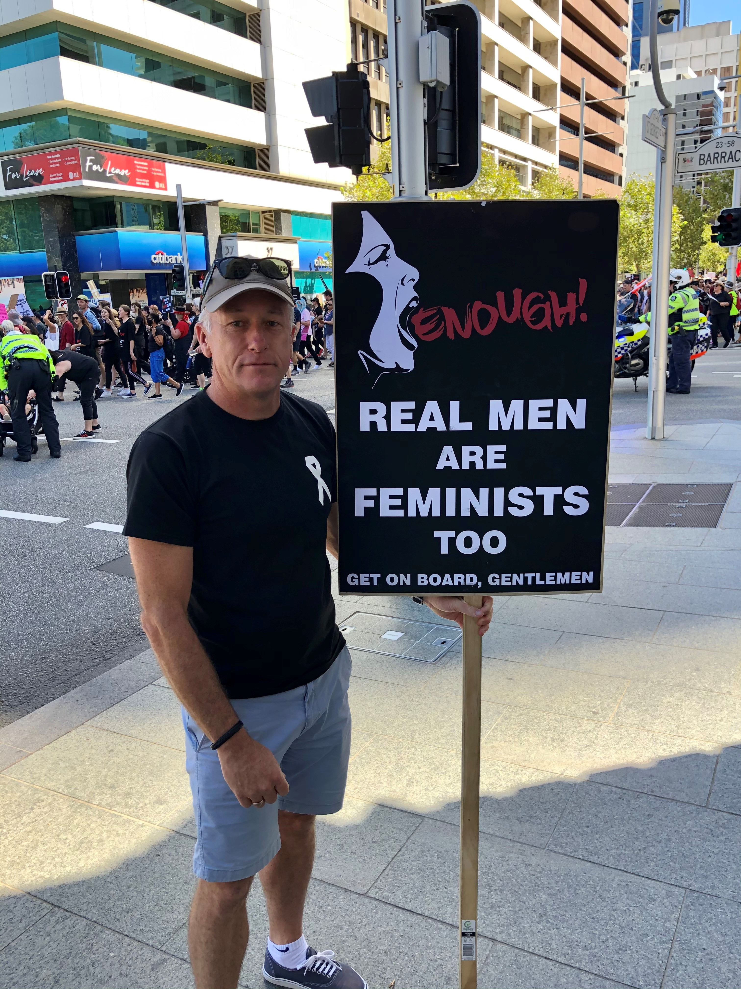




Matthew Brierley
Senior Consultant
Consultant
Co-creating Inclusive Cultures: Engaging Men
Board Member
National Association of Women in Operations (Australia & NZ)
Email: brierleys01@bigpond.com Phone: 0061 417 927 158

Slide 6

JoAnn Meyer
Joann.meyer@previseconsulting.com
Previseconsulting.com

Slide 7



A Journey to “Belonging” ?
Regulation
Policies & Programs
Impact
Compliance

